Slide 1

COVID 19 VIRUS PREDICTION

Slide 2
TEAM MEMBERS
G.SRAVYA 2103A52134
K.SIDDARTHA 2103A52144
Under the guidance of
Mr D.Ramesh
Asst.Professor
CS&ML

Slide 3
Introduction
COVID-19 primarily spreads through respiratory droplets when an infected person talks, coughs, or sneezes.
Symptoms of COVID-19 can range from mild to severe and may include fever, cough, difficulty breathing, fatigue, and loss of taste or smell.
While most people who contract COVID-19 recover without any serious complications, the disease can be severe and even fatal, particularly for older adults and people with underlying health conditions. .

Slide 4
Problem Statement
The COVID-19 pandemic has had a significant impact on the world, affecting healthcare systems, economies, and daily life.
Despite efforts to control the spread of the virus through vaccination campaigns and public health measures, the pandemic continues to pose a threat to global health and well-being.
The challenge is to develop machine learning models and algorithms that can aid in the detection, diagnosis, and treatment of COVID-19.
This includes the development of models that can accurately predict the spread of the virus and identify high-risk populations, as well as models that can analyze medical data to identify early signs of COVID-19 infection and potential complications.

Slide 5
Existing System
Covid-19 Prediction is a machine learning-based system that predicts the covid outbreak in a given region.
It uses historical data on covid-19 outbreaks, environmental factors, and human population density to make predictions.
Covid-19 Outbreak Prediction is an AI-powered system that uses data mining and predictive analytics to detect early signs of covid-19 outbreaks.
It uses data from social media, news articles, and other sources to identify patterns and trends that could indicate an outbreak.

Slide 6
Proposed System
Optimization of the data set, data cleaning, logistic regressions, svm, knn, naïve bayes, Decision tree and random forest are key metrics in this project. ​​
It analyze the data that suffers from multi-collinearity.
This produces expansion of e-commerce business and increased volume of products as well as improved website usability to navigate the desired product quickly and easily.

Slide 7
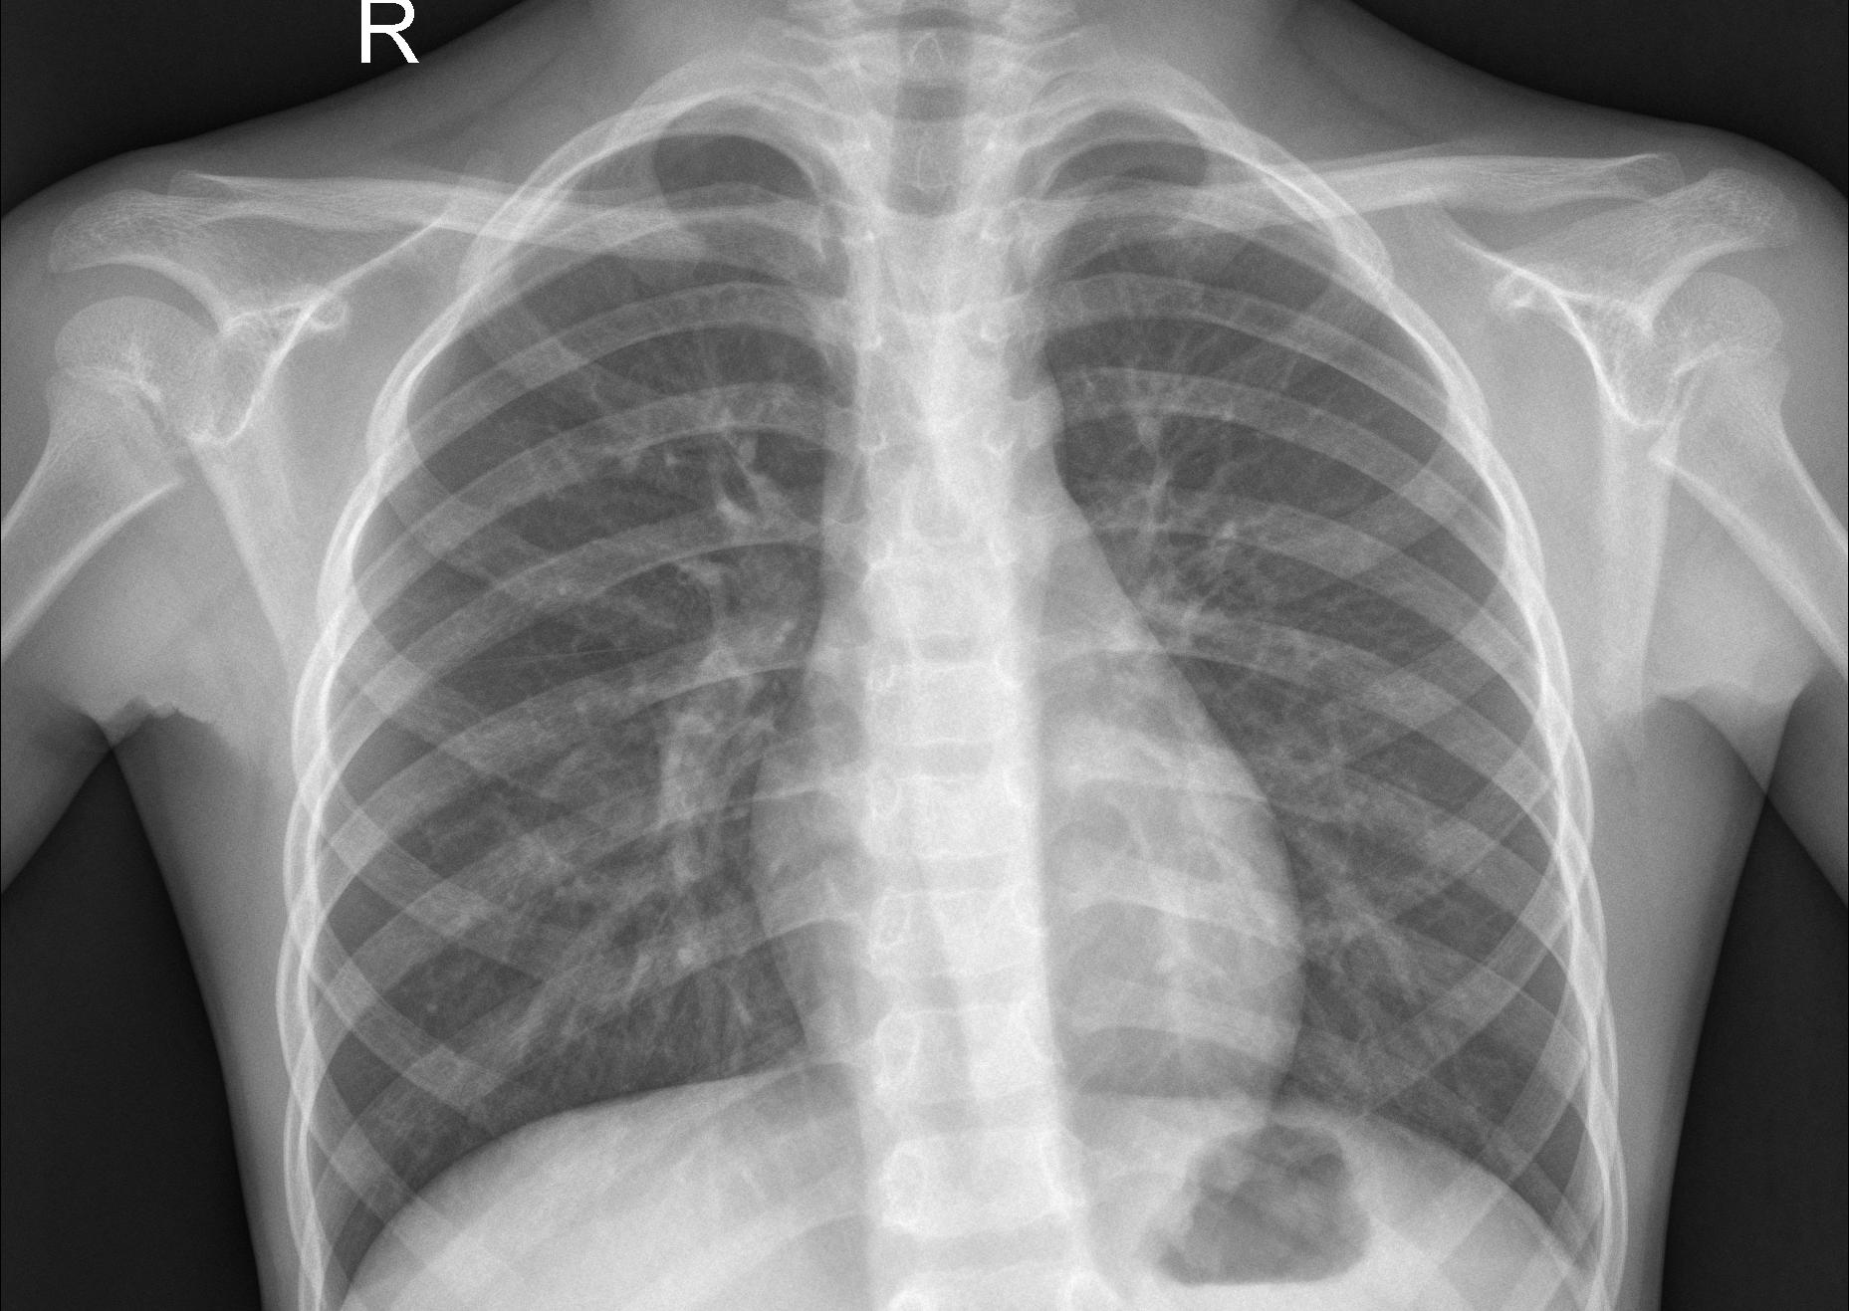
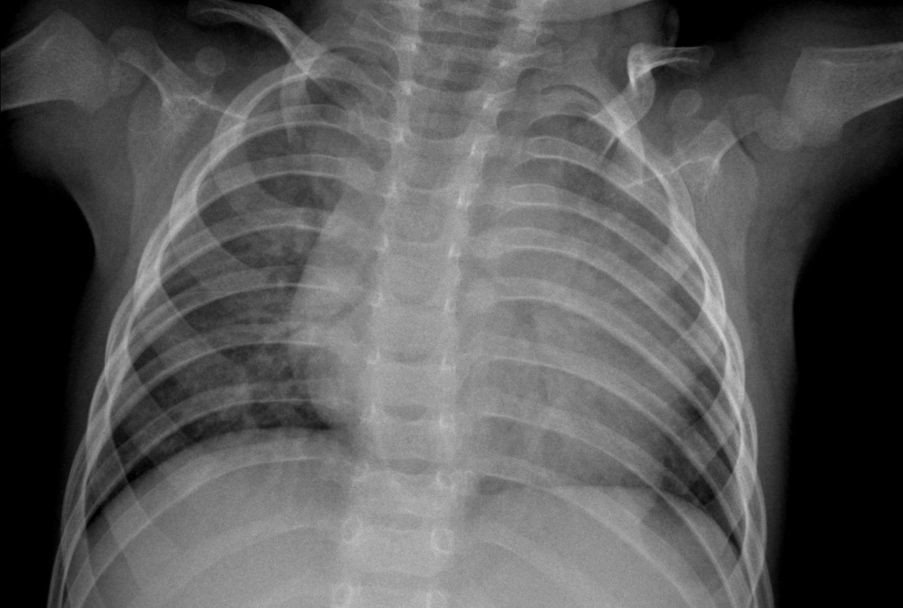
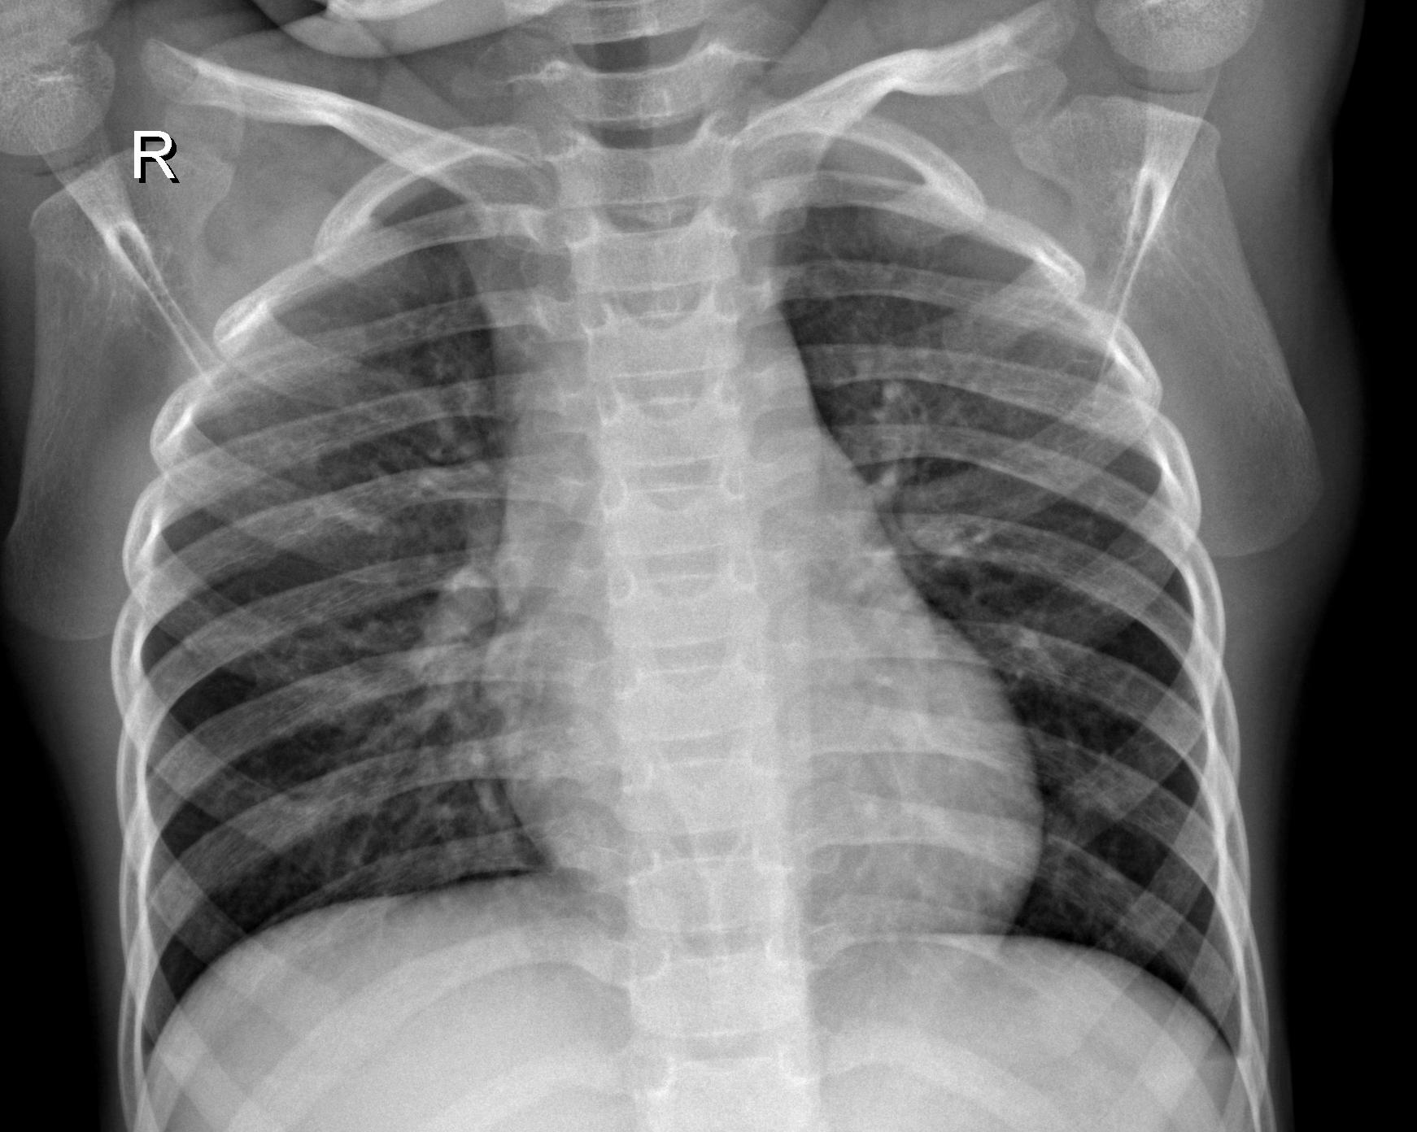
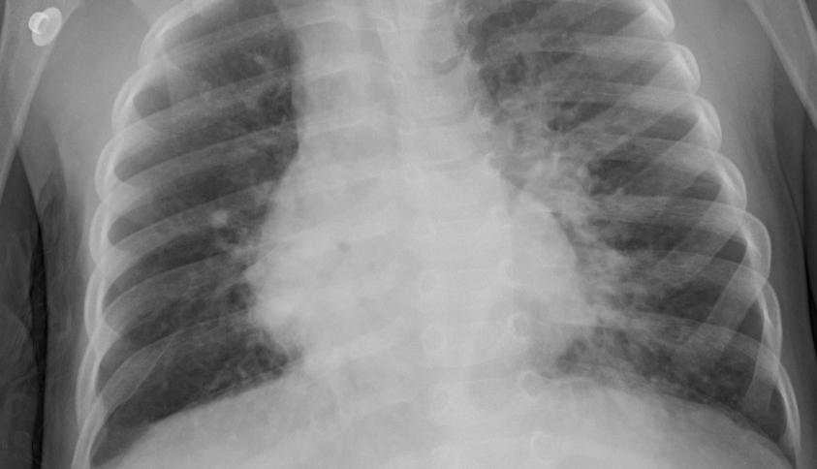
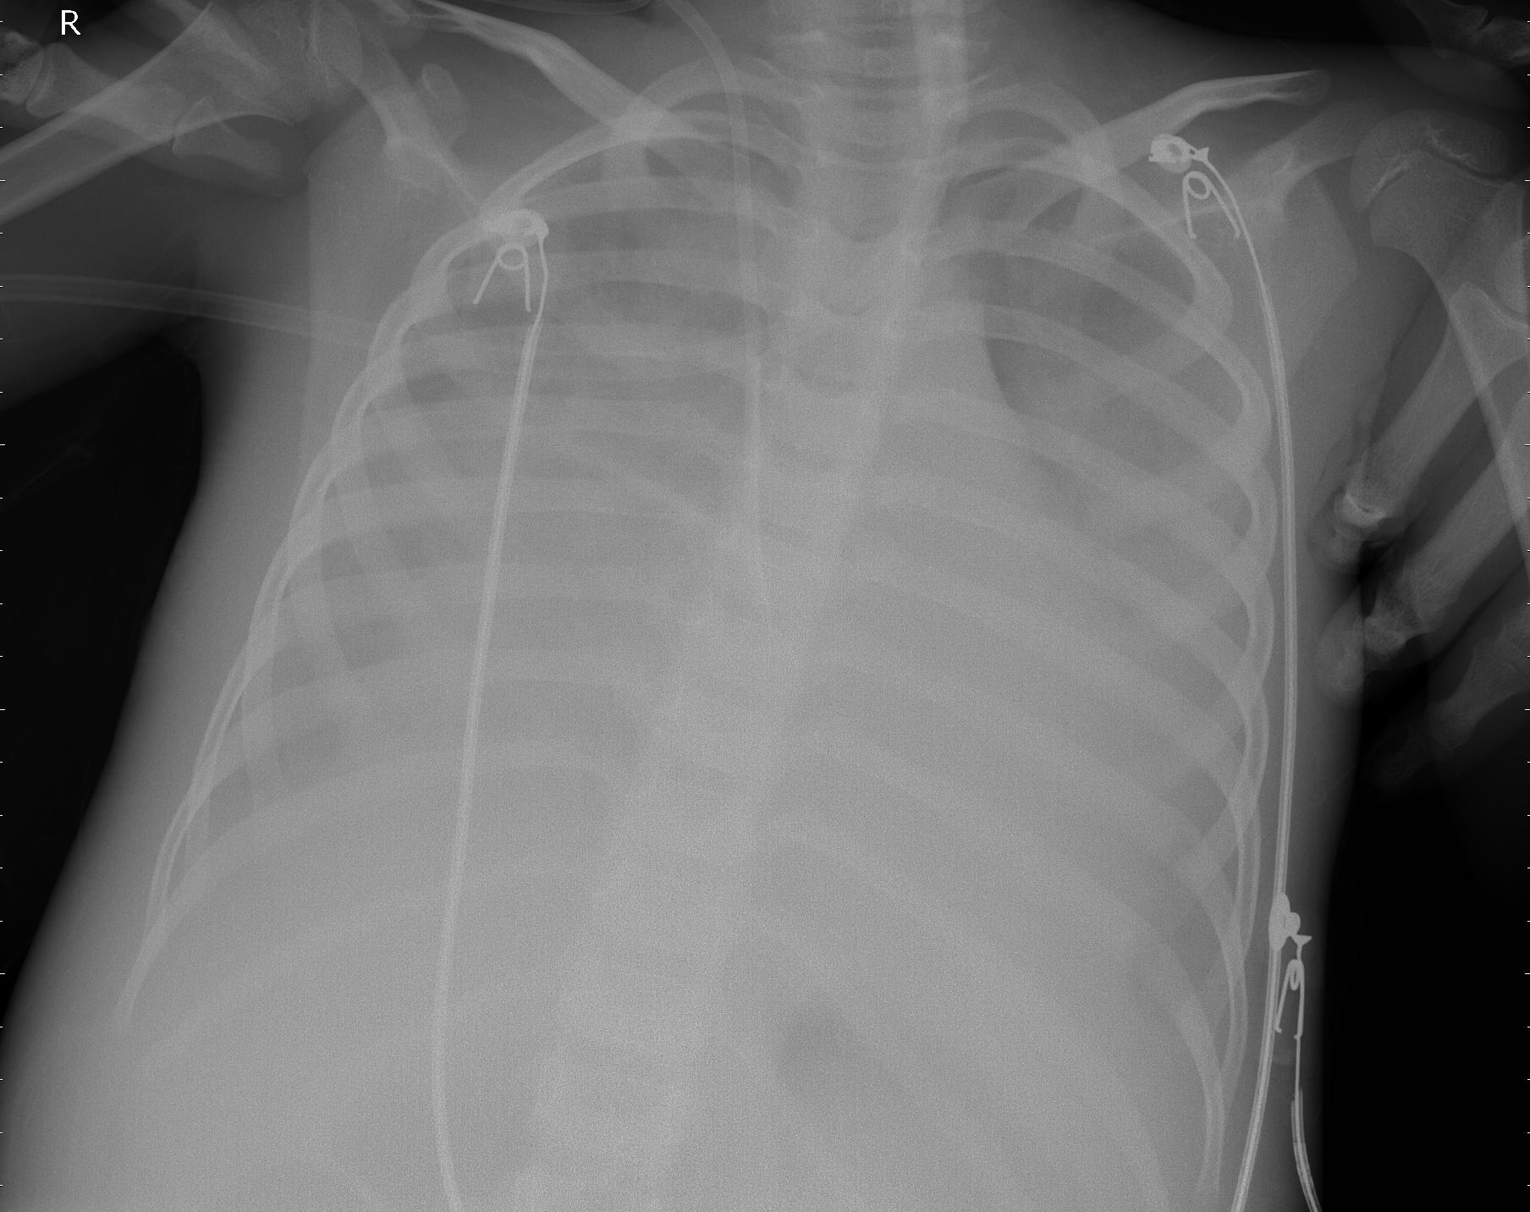
Data Set
.

Slide 8
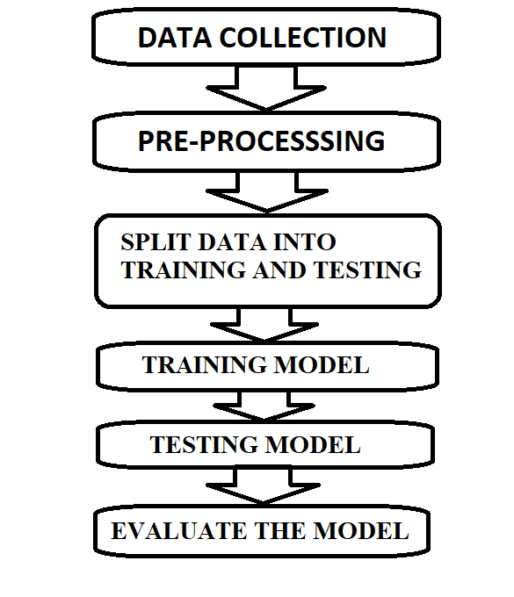
Architecture
Data collection involves gathering relevant data from
various sources such as databases, APIs, or files.
Pre-processing includes cleaning and transforming
the collected data to make it suitable for analysis,
such as removing missing values, handling outliers,
and scaling the data.
Splitting the data into training and testing sets
is necessary to train the model on a subset of the
data and evaluate its performance on the remaining data.

Slide 9
Literature Survey
It is very difficult for the doctor to identify covid 19 disease. For this several techniques are used to this we will obtain the specific models to implement or to solve them without the help of doctors. Most of these techniques are using sophisticated artificial intelligence(AI) research is known as Machine Learning.
S.NO | YEAR | METHOD | ACCURACY SCORE
1 | 2011 | Decision Tree | 96%
2 | 2013 | Decision Tree | 92%
3 | 2020 | Deep Learning | 93%

Slide 10
Methodology
LOGISTIC REGRESSION
Logistic regression is one of the most popular Machine Learning algorithms, which comes under the Supervised Learning technique.
Logistic regression is one of the most popular Machine Learning algorithms, which comes under the Supervised Learning technique.
Covid-19 Logistic regression predicts the output of a categorical dependent variable. Therefore the outcome must be a categorical or discrete value.
Out It can be either Yes or No, 0 or 1, true or False, etc. but instead of giving the exact value as 0 and 1, it gives the probabilistic values which lie between 0 and 1
RESULT: 96.50%

Slide 11
KNN
K-Nearest Neighbour is one of the simplest Machine Learning algorithms based on Supervised Learning technique.
K-NN algorithm assumes the similarity between the new case/data and available cases and put the new case into the category that is most similar to the available categories..
. K-NN algorithm can be used for Regression as well as for Classification but mostly it is used for the Classification problems
K-NN is a non-parametric algorithm, which means it does not make any assumption on underlying data.
RESULT: 82%

Slide 12
SUPPORT VECTOR MACHINE(SVM)
Support Vector Machine or SVM is one of the most popular Supervised Learning algorithms, which is used for Classification as well as Regression problems.
However, primarily, it is used for Classification problems in Machine Learning.
The goal of the SVM algorithm is to create the best line or decision boundary that can segregate n-dimensional space into classes so that we can easily put the new data point in the correct category in the future.
This best decision boundary is called a hyperplane
RESULT: 93%

Slide 13
NAÏVE BAYES
Naïve Bayes algorithm is a supervised learning algorithm, which is based on Bayes theorem and used for solving classification problems.
It is mainly used in text classification that includes a high-dimensional training dataset.
Naïve Bayes Classifier is one of the simple and most effective Classification algorithms which helps in building the fast machine learning models that can make quick predictions.
It is a probabilistic classifier, which means it predicts on the basis of the probability of an object.
RESULT: 79%

Slide 14
DECISION TREE
In a decision tree, which resembles a flowchart, an inner node represents a variable (or a feature) of the dataset, a tree branch indicates a decision rule, and every leaf node indicates the outcome of the specific decision.
The first node from the top of a decision tree diagram is the root node. We can split up data based on the attribute values that correspond to the independent characteristics.
The recursive partitioning method is for the division of a tree into distinct elements.
Making decisions is aided by this decision tree's comprehensive structure, which looks like a flowchart.
RESULT: 91%

Slide 15
RANDOM FOREST
Random Forest is a popular machine learning algorithm that belongs to the supervised learning technique. It can be used for both Classification and Regression problems in ML. It is based on the concept of ensemble learning, which is a process of combining multiple classifiers to solve a complex problem and to improve the performance of the model.
As the name suggests, "Random Forest is a classifier that contains a number of decision trees on various subsets of the given dataset and takes the average to improve the predictive accuracy of that dataset.“
RESULT: 94.84%

Slide 16
RESULT
Machine Learning Model | Accuracy
Logistic Regression | 94.50%
KNN | 82%
Naïve Bayes | 79%
Support Vector System | 93%
Decision Tree | 91%
Random Forest | 94.84%

Slide 17
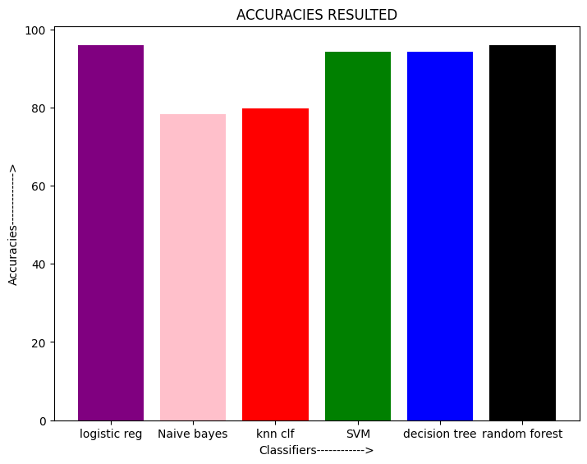
RESULTANT GRAPH

Slide 18
CONCLUSION
Covid 19 is a potentially severe viral disease that can lead to outbreaks in humans. Early detection and prediction of the disease can help in controlling its spread and reducing its impact on human populations. Machine learning models have been successfully applied in predicting and detecting the occurrence of the disease using various features such as human behavior. However, there is a need for more comprehensive data and research to improve the accuracy and reliability of these models. In addition, the methodology presented in this study may benefit the health system response to future epidemic waves of this disease and of other respiratory viruses in general.

Slide 19
FUTURE SCOPE
The pandemic of COVID-19 has affected the entire globe. It has spread in more than 85 countries as of Apr. 2020. Scientists have made every effort to find solutions to it; according to claims by the United States and India, some vaccines have been made that are being trialed. The use of computers by scientists for early prediction has been widespread. A lot of research is taking place using ML to combat COVID-19. This chapter can be used by different researchers to learn how ML can be employed to forecast not only this situation but also other cases. The chapter specifically used the ARIMA method of time to forecast the stability and growth of COVID-19.

Slide 20
THANK YOU

